Slide 1

“Platform for the automation of requests for technological supplies”
CAPSTONE PRESENTATION
Teacher
Marcela Orellana Silva
Team
Camilo Chavez Chavez
Hugo González Yáñez
Diego Osores Guzman
Bayron Ventura González
Duoc UC San Bernardo
School of Computer Science and Telecommunications
Computer Engineering
2025

Slide 2
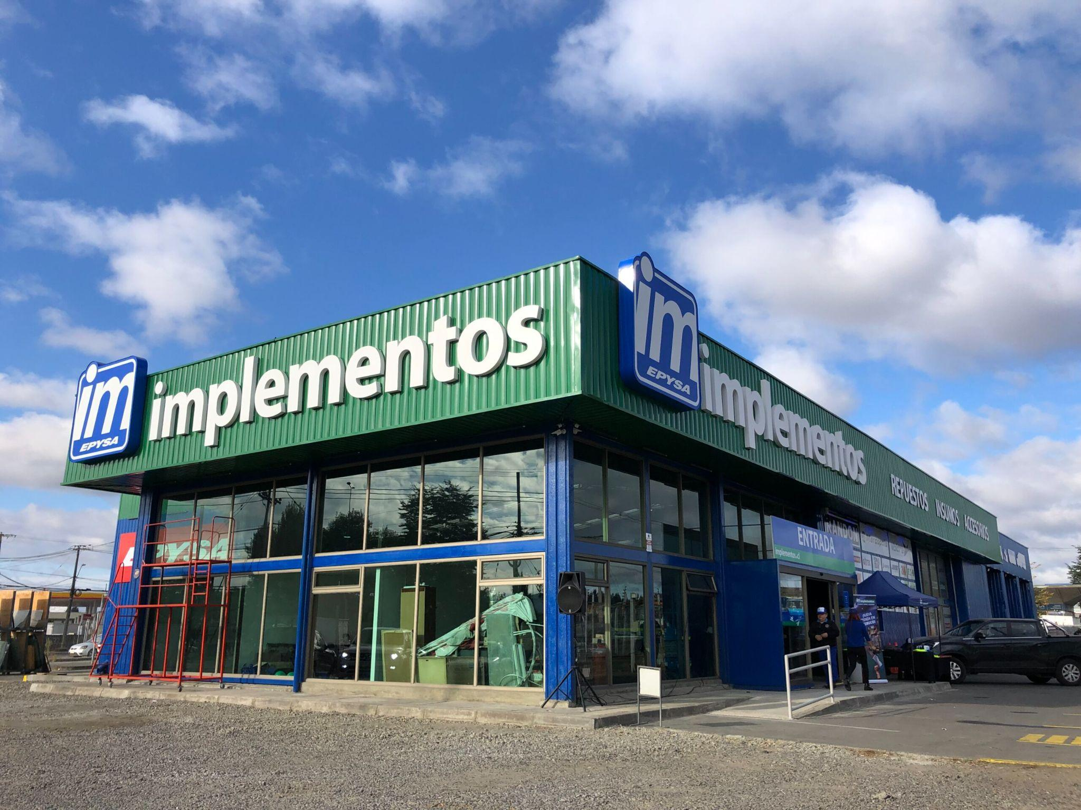
Introduction
The project focuses on automating requests for technological supplies at Implementos Epysa S.A., a process currently handled via email and spreadsheets, resulting in delays, duplicate records, lost information, and a lack of real-time inventory control.
Resolving this issue is crucial, as it impacts operational continuity, hinders planning, and limits the company's responsiveness.
To address this need, the project proposes a full-stack web platform that integrates centralized requests, real-time inventory management, automatic prioritization, internal notifications, and strategic reports.
This solution reduces administrative errors, optimizes response times, and strengthens traceability, directly supporting the company's digital transformation.
Notes:
Descripción breve de la temática a tratar.
Debe comprender, en forma simple:
resumen de lo que se aborda y por qué es importante de resolver.
Resumen de la solución

Slide 3
Defining the context
Epysa S.A. implements, where the management of requests for technological supplies is done manually via emails and spreadsheets, as described in the report.
Problem or need: This manual process generates delays, duplicate records, loss of information, and a lack of real-time inventory control, affecting the company's operational continuity.
As noted in the introduction, these limitations highlight the need for a platform that automates and standardizes the process, ensuring efficiency, traceability, and support for Epysa S.A.'s digital transformation.
Notes:
Se define el entorno del proyecto en que se desarrolla el proyecto y el problema que resolverá .
el problema o necesidad
Es conveniente hilar con la introducción.

Slide 4

General objective
Specific Objectives
Automate the management of requests for technological supplies at Implementos Epysa S.A. by developing a web platform that allows reducing administrative errors, optimizing response times, and improving real-time inventory traceability.
Develop a responsive web interface that allows employees to create and track their supply requests.
Configure an automatic prioritization system for requests based on urgency or criticality of the area.
Integrate an internal notification system and email notifications to keep users informed about the status of their requests.
Generate strategic consumption and inventory reports to support decision-making and organizational planning.
Notes:
Objetivos del proyecto
Escribir el Objetivo general
Listar objetivos específicos

Slide 5


Methodology and Main Phases
Iterative Incremental Development
Main Phases
Analysis and Requirements Gathering → interviews, As-Is and To-Be workflows.
System Design → data model, UML diagrams, interface prototypes.
Development → frontend in React, backend in Laravel, MySQL database.
Testing and Integration → unit, functional, and performance testing.
Deployment and Training → user guides, team training.
Evaluation and Continuous Improvement → satisfaction surveys, efficiency metrics, final adjustments.
Iterative-incremental methodology: successive cycles of analysis, design, development, testing, and feedback.
Comprehensive planning with a Gantt chart: definition of phases, dependencies, and deadlines.
Progress management through regular meetings and progress reports: collaborative monitoring of progress and resolution of issues.
Notes:
METODOLOGÍA DE DESARROLLO
Describir la metodología utilizada y su relación con el proyecto.
Puede ser más de una diapositiva.
Nombre de estudiante
Cargo y Funciones desempeñadas

Slide 6
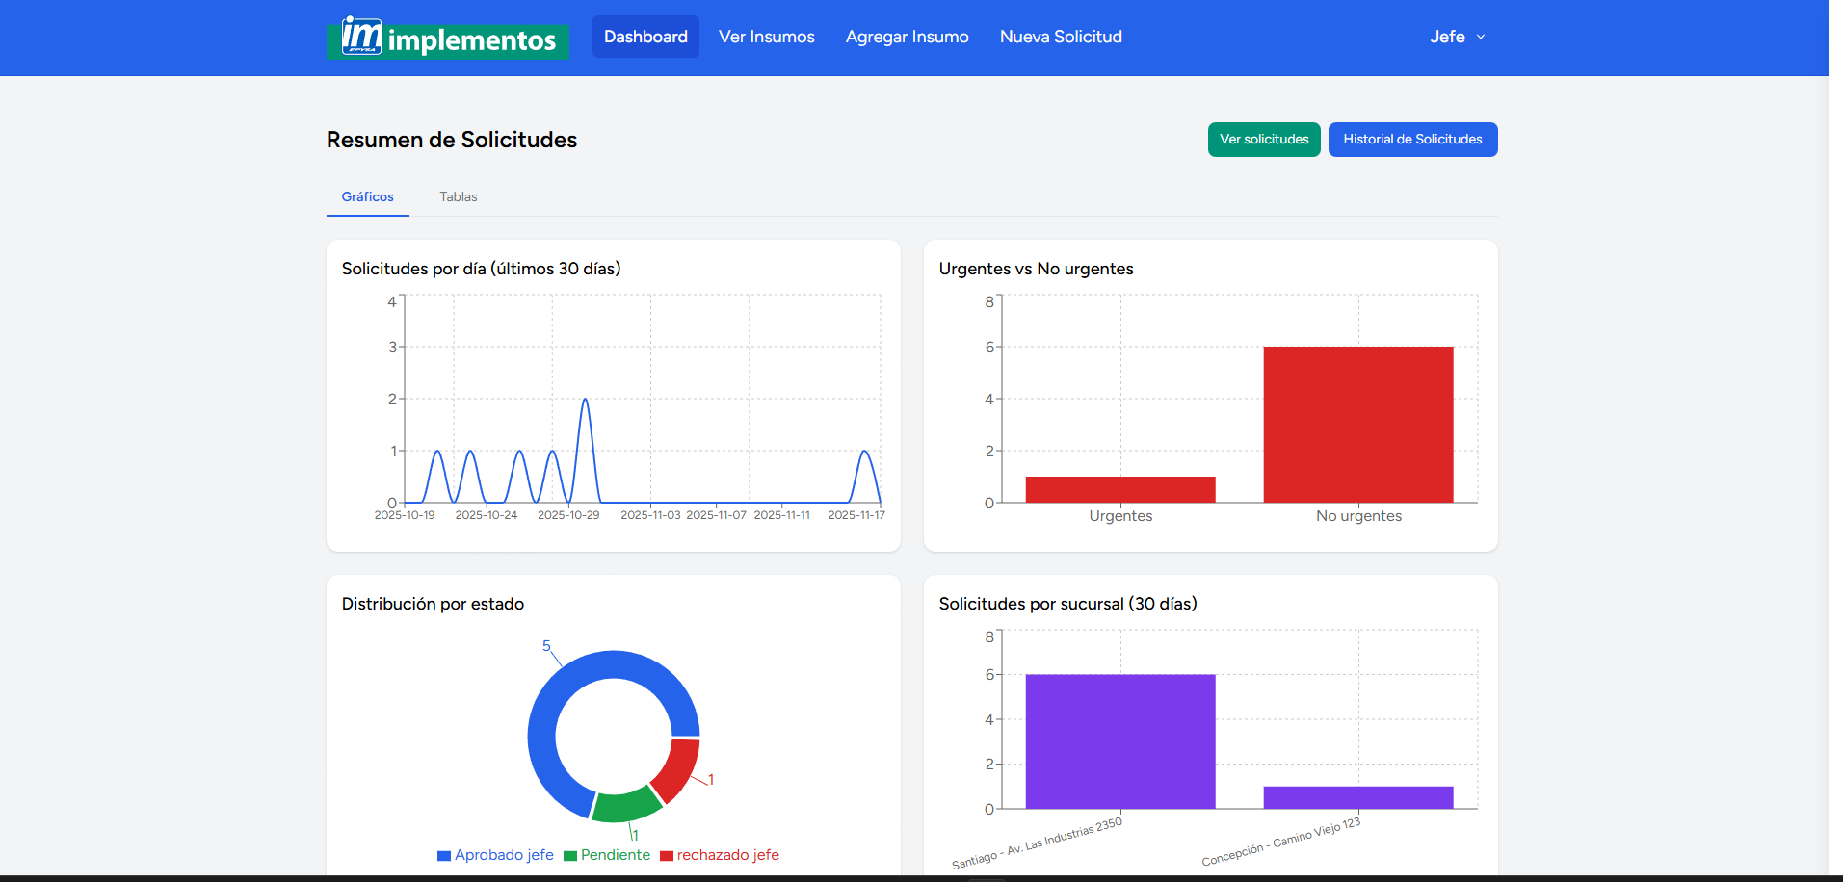
Solution Proposal
Develop a full-stack web platform that automates the process of requesting technological supplies at Implementos Epysa S.A., integrating real-time inventory management, complete process traceability, and tools that improve operational efficiency.
Solution Components
Frontend: React
Backend: Laravel (system logic, security)
Database: MySQL in a XAMPP/phpMyAdmin environment
Notifications: SMTP for internal alerts and status updates
Iterative-Incremental Methodology, Studies and Inputs Used
Process Modeling: AS-IS and TO-BE Diagrams
Analysis: Requirements Gathering through Interviews
Design: Use Cases, UML, ER Diagrams, Activity Diagrams, Object Diagrams, Extended Use Cases, Class Diagrams, Sequence Diagrams, Component Diagrams, Deployment Diagrams, Figma Prototypes
Project Management: Gantt Chart
Notes:
Componentes
Es decir, el resumen de aspectos relevantes .
Esto implica “LISTAR”
Arquitectura, Componentes, Estimaciones de Costo, estudios y otros usado en el estudio, panificación y diseño del proyecto
Se describe la propuesta de solución del proyecto.
Puede usar más diapositivas para hablar se sus componentes

Slide 7
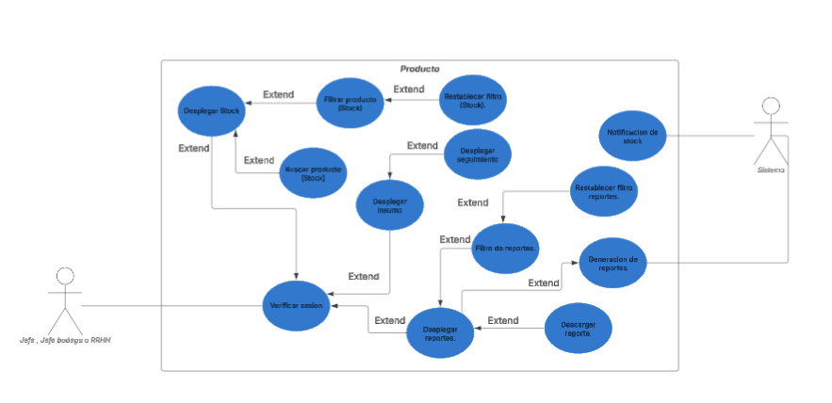
Use cases

Slide 8
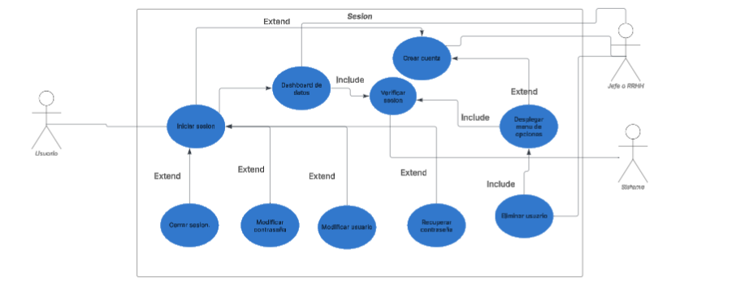
Use cases

Slide 9
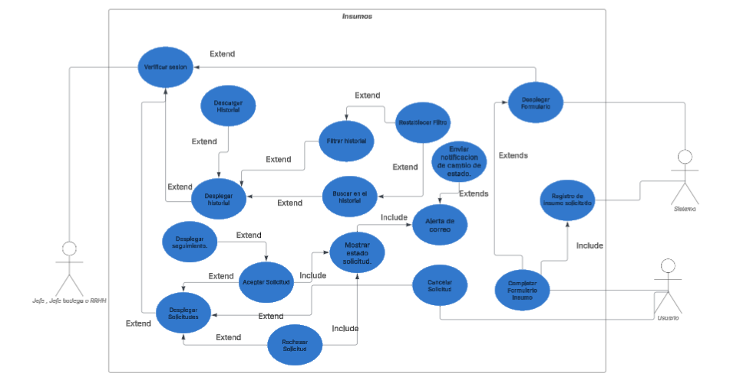
Use cases

Slide 10
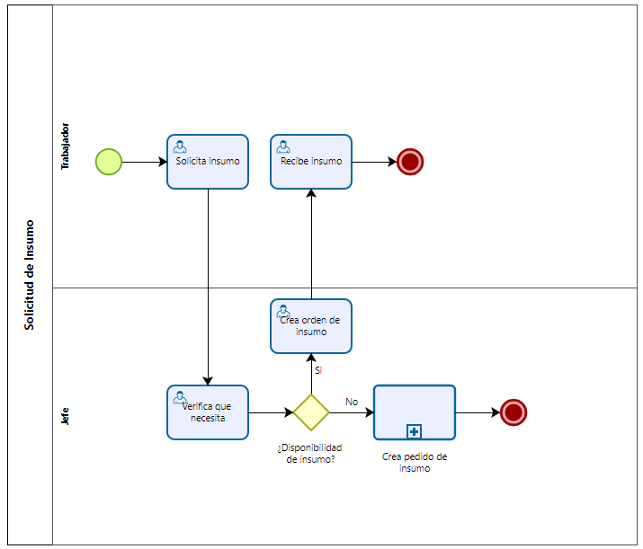
AS-IS
The procedure is manual and unstructured, with a basic sequence between the worker and the supervisor. This rather rudimentary flow limits traceability, hinders the control of requests, and does not allow for efficient management of time or resources.
Necesidad de insumo

Slide 11
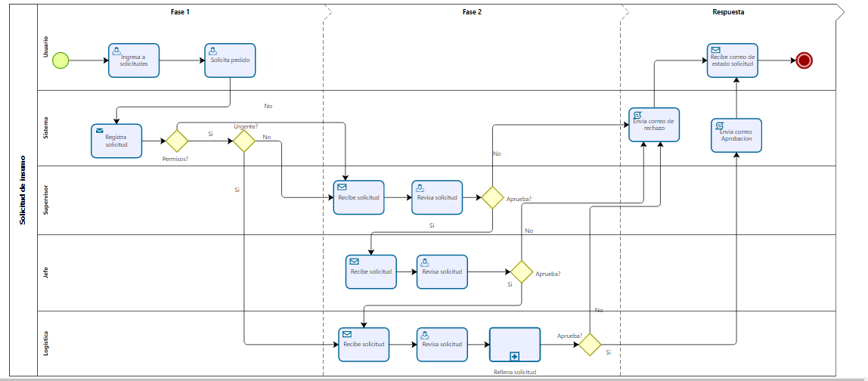
TO-BE
Clear role-based structure
Automated validations and decisions
Greater transparency and monitoring
Reduced time and operational burden
Foundation for technological implementation

Slide 12
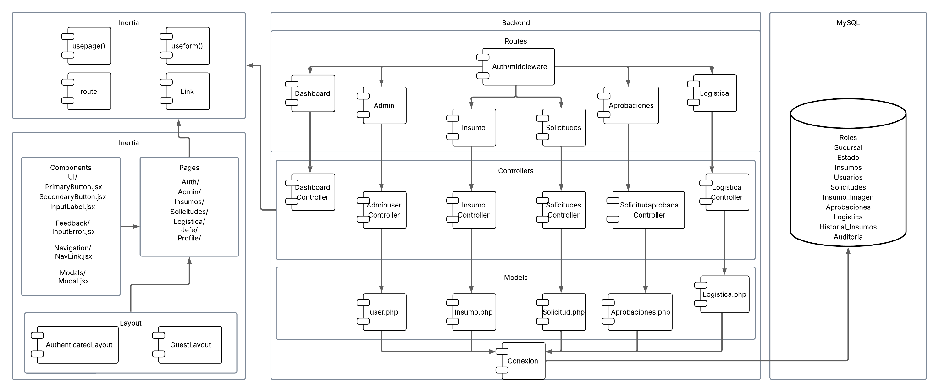
Software architecture
Pros:
Preventing misuse of supplies: Supplies are only delivered with authorization.
Decision history: A record is kept of who approves, when, and why.
Resource optimization: Requests are prioritized based on urgency or availability.
Waste reduction: Only what is needed is delivered.
Cons:
Lack of a culture of control: This can lead to resistance or non-compliance.
Misalignment between departments: They may have different criteria regarding what to approve and when.

Slide 13
Conclusiones
The project's development effectively addressed the problem identified at Implementos Epysa S.A., demonstrating that manual inventory management generates critical inefficiencies, as reported in previous inventory studies. The implementation of the web platform achieved results aligned with the established objectives:
● Request automation: A responsive web interface was built to centralize and standardize the entry of requests, reducing errors and data duplication.
● Automatic prioritization: The system incorporated configurable rules that expedite the handling of critical requests, optimizing response times.
● Strategic report generation: The platform includes dashboards that provide relevant information for planning and decision-making.
● Notifications and alerts: Internal communication mechanisms were integrated to enhance process traceability.

Slide 14
thank you for your time
“Platform for the automation of requests for technological supplies”
Teacher
Marcela Orellana Silva
Team
Camilo Chavez Chavez
Hugo González Yáñez
Diego Osores Guzman
Bayron Ventura González
Duoc UC San Bernardo
School of Computer Science and Telecommunications
Computer Engineering
2025

